Slide 1
Molecule Shapes
Learning Goals: Students will be able to:
Identify substances to which “Molecular geometry” applies.
Name molecule and electron geometries for basic molecules.
Explain the model being used to predict molecule geometry.
Predict common molecular geometry from the number of electron pairs and bonded atoms around a central atom of basic compounds.
by Trish Loeblein updated October 2011

Slide 2
Which is a molecule?
CO₂
CaCl₂
NH₄Cl
Li₂SO₄
Notes:
Make sure to ask :How did you decide?
A because it has only non-metals; Remind students that ionic compounds made of metals-nonmetals or polyatomic ions are not.

Slide 3
2. Which would have a linear shape?
HBr
CO₂
Both are linear
Notes:
C

Slide 4
3. Which has only single bonds?
HBr
CO₂
Both have all single bonds
Notes:
A

Slide 5
4. What shape is water?
Tetrahedral
Bent
Trigonal planar
Linear
Notes:
B

Slide 6
5. Which is an example of an exception to the octet rule?
O₂
N₂
BF₃
I₂
More than one of these
Notes:
Make sure to ask :How did you decide?
C

Slide 7
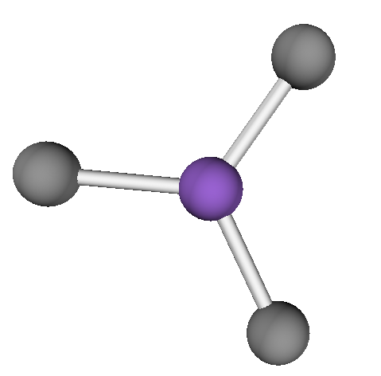
5ans. Which is an example of an exception to the octet rule?
O₂
N₂
BF₃
I₂
More than one of these
Notes:
Make sure to ask :How did you decide?
C

Slide 8
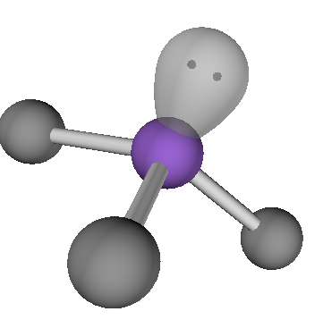
6. Which molecule could be represented with this diagram?
BH₃
CH₄
NH₃
6b. What would the structural formula look like?
Notes:
C

Slide 9
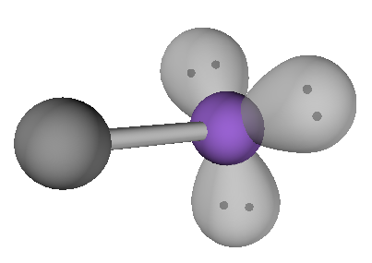
7. Which molecule could be represented with this diagram?
HCl
CH₄
NH₃
F₂
7b. What would the structural formula look like?
Notes:
A

